Slide 1

ASP.NET Core
.json files(project.json,appsettings.json,launchsettings.json)

Slide 2
Project.json
Project.json is heart of .NET Application
View of project.json:
We have version information at the top of this file
"dependencies":
{ "Microsoft.NETCore.App": { "version": "1.0.0", "type": "platform" },
Top-level NuGet packages
"Microsoft.AspNetCore.Diagnostics": "1.0.0", "Microsoft.AspNetCore.Server.IISIntegration": "1.0.0", "Microsoft.AspNetCore.Server.Kestrel": "1.0.0" }
We can even add new dependencies by typing here or right clikc reference and selecting it

Slide 3
This section says which of the .NET frameworks your application can use
"frameworks":
{ "netcoreapp1.0": { "imports": ["dotnet5.6", "portable-net45+win8"] }

Slide 4
Appsettings.json file

Slide 5
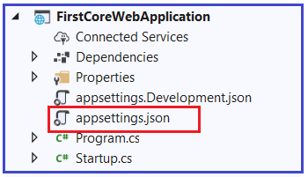
What is ASP.NET Core appsettings.json File?
Visual studio automatically creates the appsettings.json file
The appsettings.json file is an application configuration file
It is used to store configuration settings such as
database connections strings,
any application scope global variables, etc.

Slide 6
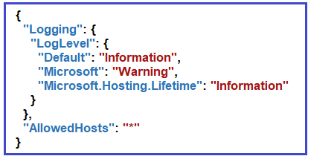
ASP.NET Core appsettings.json file
Step 1: To add a key with the name MyCustomKey within this file:
Store the value in the form of key-value pair
{
"Logging": {
"LogLevel": {
"Default": "Information",
"Microsoft": "Warning",
"Microsoft.Hosting.Lifetime": "Information"
}
},
"AllowedHosts": "*",
"MyCustomKey": "MyCustomKey Value coming from appsettings.json"
}

Slide 7
Step 2: To access the configuration information in the ASP.NET Core application
Use the IConfiguration service
Inject the IConfiguration service through the constructor of the Startup class
public class Startup
{
private IConfiguration _config;
// Here we are using Dependency Injection to inject the Configuration object
public Startup(IConfiguration config)
{
_config = config;
}

Slide 8
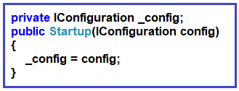
Create a private variable of type IConfiguration _config
Then through constructor dependency injection we inject the IConfiguration object and store it within the private variable _config.
public void Configure(IApplicationBuilder app, IWebHostEnvironment env)
{
if (env.IsDevelopment())
{
app.UseDeveloperExceptionPage();
}
app.UseRouting();
app.UseEndpoints(endpoints =>
{
endpoints.MapGet("/", async context =>
{
await context.Response.WriteAsync(_config["MyCustomKey"]);
}

Slide 9
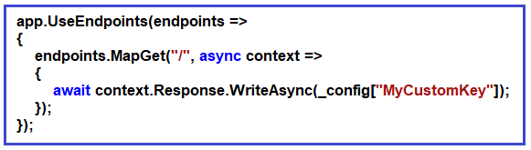
Then we access the configuration variable i.e. MyCustomKey using the IConfiguration service instance
Step 3: Set the AspNetCoreHostingModel value to InProcess in the application’s project file
<Project Sdk="Microsoft.NET.Sdk.Web">
<PropertyGroup>
<TargetFramework>netcoreapp3.1</TargetFramework>
<AspNetCoreHostingModel>InProcess</AspNetCoreHostingModel>
</PropertyGroup>
</Project>

Slide 10
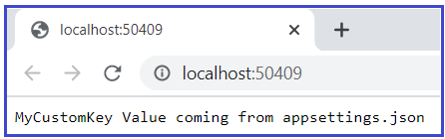
Run the application

Slide 11
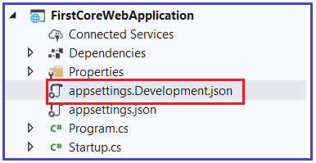
Configuration Execution Order
Modify the file as follows
{
"Logging": {
"LogLevel": {
"Default": "Information",
"Microsoft": "Warning",
"Microsoft.Hosting.Lifetime": "Information"
}
},
"MyCustomKey": "MyCustomKey Value coming from appsettings.Development.json"
}
Run the application

Slide 12
What are the Default Orders of reading the configuration sources?
The default orders in which the various configuration sources are read for the same key are as follows
appsettings.json,
appsettings.{Environment}.json here we use appsettings.development.json
User secrets
Environment variables
Command-line arguments

Slide 13
We already have MyCustomKey in two places i.e. appsettings.json and appsettings.development.json.
Now add the same key as “MyCustomKey”: “MyCustomKey Value coming from Environment Variable of launchsSettings.json”
We can see this page runs when app gets started

Slide 14
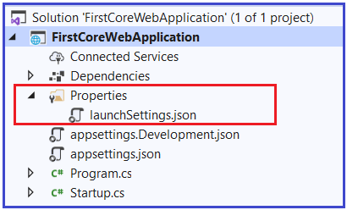
Launchsettings.json
Create the Empty ASP.NET Core Web Application. See the file below
The settings that are present within this file are going to be used when we run the .NET core application
Notes:
https://dotnettutorials.net/lesson/asp-net-core-launchsettings-json-file/
When we run an application , the settings for the supplication is received from this file.
It will be in solution explorer under project folder.
we can host our application in two ways
Inprocess
Outofprocess
Inprocess - It will run our application in IIS Express
Outpfprocess – It will run our application in dotnet.exe
Kestrel is out internal webserver and iisexpress is our external web server. This process http requests and gives to kestrel
IIS will be used only in production environment

Slide 15
This file is only used within the local development machine
Not when we publish our asp.net core application to the production server.
Note: if we want to apply certain settings in production environment then use appsettings.json file
See notes below for Diff b/w kestrel and iis
Notes:
Diff b/w kestrel and iis
IIS has many features where kestrel doesn’t have like security etc
But kestrel runs in linux without any issues as it supports cross platform whereas iis doesn’t
Kestrel can be stood up immediately from code with little to no configuration without modifying the machine’s features or running an installer of any kind. It’s basically completely portable.
That’s y we use kestrel but IIS has all features except running on linux etc
Refer this link for more info: https://dotnetcoretutorials.com/2019/12/25/kestrel-vs-iis/#:~:text=Multiple%20apps%20on%20the%20same,can't%20then%20start%20another%20.

Slide 16
Profile settings in the launchSettings.json file:
"iisSettings": {
"windowsAuthentication": false,
"anonymousAuthentication": true,
"iisExpress": {
"applicationUrl": "http://localhost:50409",
"sslPort": 0
}
},
"profiles": {
"IIS Express": {
"commandName": "IISExpress",
"launchBrowser": true,
"environmentVariables": {
"ASPNETCORE_ENVIRONMENT": "Development"
}
},
"FirstCoreWebApplication": {
"commandName": "Project",
"launchBrowser": true,
"applicationUrl": "http://localhost:5000",
"environmentVariables": {
"ASPNETCORE_ENVIRONMENT": "Development"
}
}
}
}

Slide 17
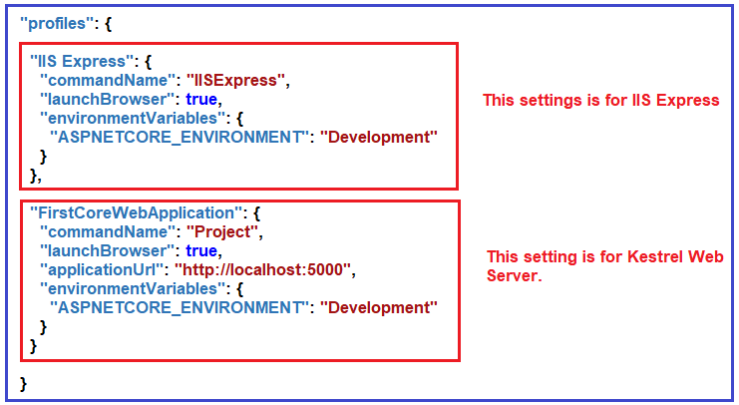
In the above launchSettings.json file, within the profiles, we have two sections i.e. IIS Express and FirstCoreWebApplication as shown in the below image.
When run the application from Visual Studio either by pressing CTRL + F5 or just F5 then by default the profile with “commandName”: “IISExpress” is going to be used.
On the other hand, if you run the ASP.NET Core application using .NET Core CLI (i.e. dotnet run command), then the profile with the “commandName”: “Project” is going to be used.

Slide 18
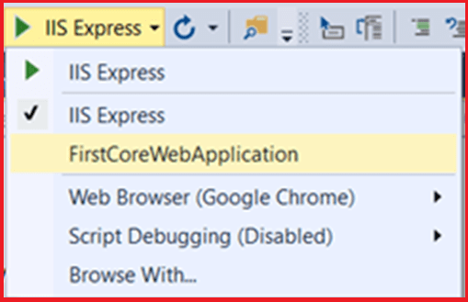
This is where we select our profile from

Slide 19
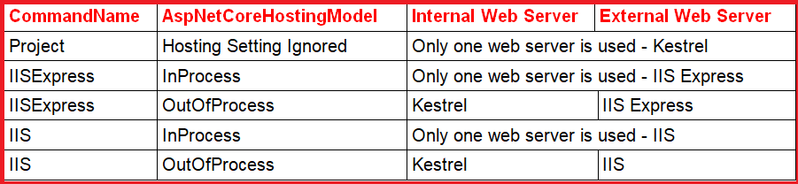
The value of the commandName property of the launchSettings.json file can be any one of the following.
IISExpress
IIS
Project

Slide 20

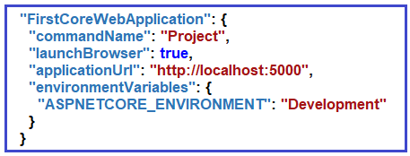
Case1: CommandName as Project
Launch Profile as FirstCoreWebApplication as shown below.
In launchsettings.json file FirstCoreWebApplication profile uses the “commandName”: “Project” value and URL is http://localhost:5000
Notes:
When we use the CommandName as Project in the launchSettings.json file, then ASP.NET Core is going to ignore the AspNetCoreHostingModel value.
The Kestrel is the only server that is going to host the application and handle the incoming request.

Slide 21
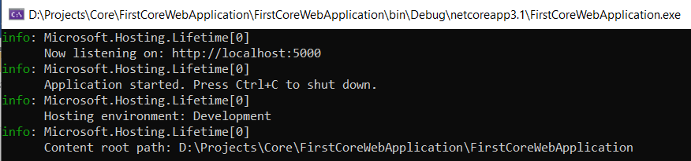
Change the AspNetCoreHostingModel element value to InProcess
If you run the project either by pressing CTRL + F5 or just F5, first it will launch the command prompt where it will host the application using the Kestrel server

Slide 22
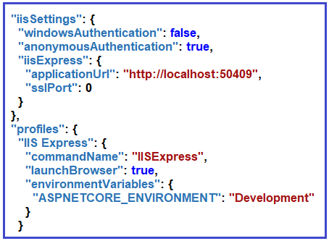

Case2: CommandName as IISExpress and AspNetCoreHostingModel as InProcess
CommandName as IISExpress
pressing CTRL + F5 or just F5, iisexpress is the
worker process name, IIS Express is the only
web server that is going to host the application as well as handles the incoming HTTP Requests.
Notes:
if we set the AspNetCoreHostingModel value as InProcess in the applications project file, then IIS Express is the only server that is going to host and handle the incoming HTTP request.

Slide 23
Case3: CommandName as IISExpress and AspNetCoreHostingModel as OutOfProcess
CommandName as IISExpress profile
Set the AspNetCoreHostingModel value as OutOfProcess
(ASP.NET Core uses IIS Express as the external web server and Kestrel is the internal webserver)
Notes:
The external web server i.e. IIS Express will receive the incoming HTTP Requests and then forward the request to the internal web server i.e. Kestrel which is going to process the request. Let us prove this

Slide 24
Thank you

Slide 25
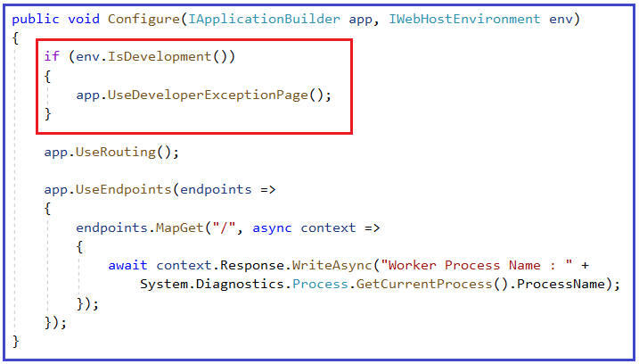
To find out the server which is running by pressing ctrl+F5 do the below code in startup.cs file

